Slide 1
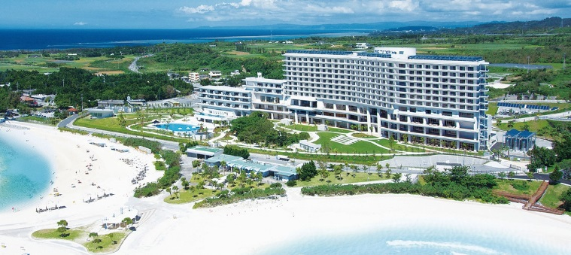
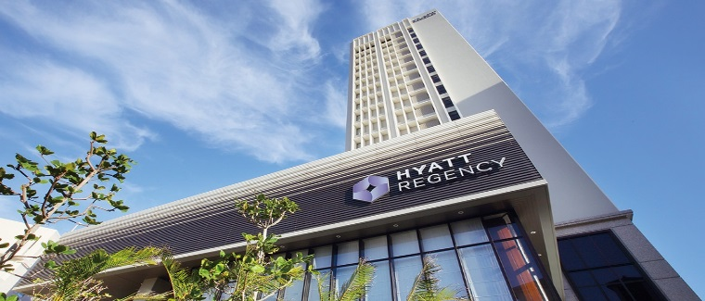
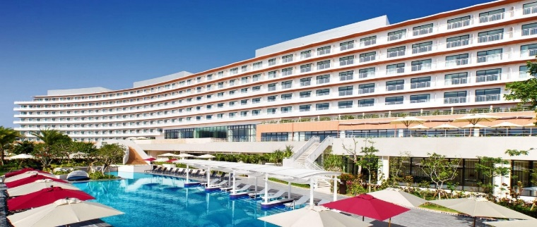
The reason why holding your MICE in Okinawa
Excellent hotels for a comfortable stay
Hotel Orion Motobu Resort & Spa
The panoramic ocean view from your room instantly creates a resort mood. The hotel has a large banquet hall which can be used by the large groups. Heal your tired mind and body in the natural hot spring and spa. It is just a few minutes' walk from Okinawa Churaumi Aquarium and Emerald Beach on foot.
Hyatt Regency Naha, Okinawa
Located near Kokusai Dori Street. Enjoy international class service combined with Okinawan-style hospitality. The hotel offers everything you need in one location from the banquet rooms, to shops and a pool. It is easily accessible to the hotel. It takes 20 minutes by car from Naha Airport, a 3 minutes walk from Kokusai Dori Street.
Hilton Okinawa Chatan Resort
The Hilton Okinawa Chatan Resort locates on the west coast of Chatan which is popular for diving. The hotel offers banquet rooms, meeting rooms and a business center. Close to major attractions such as Mihama American Village, you can fully enjoy shopping and marine activities.

